Slide 1

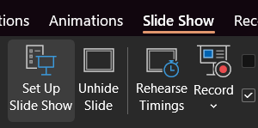
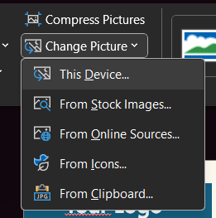
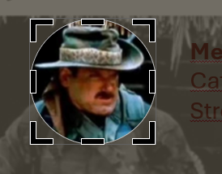
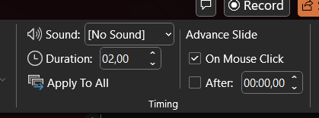
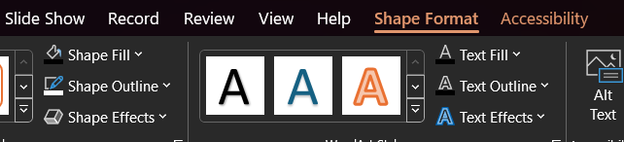
Changing Pictures
Select the image you want to update
Go to ‘Picture Format’ tab
Go to ‘Change Picture’ – ‘This Device’ and select an image.
In the same tab use ‘Crop’ option to adjust the exact image position within the shape.
Animations
Presentation is set to Kiosk mode via ‘Slide Show’ tab’s ‘Set Up Slide Show’ options.
1
3
Transitions are set up via the ‘Transitions’ tab
and set to occur after a specific amount of time,
using ‘Morph’ effect.
4
If you don’t want the animations simply hide one of the slides.
Changing Colors
Use the ‘Shape Format’ or ‘Graphics Format’ tab to edit the colors of each element you’ve selected.
Fonts used
Afacad Flux
Protest Riot
Freely available under
SIL Open Font License

Slide 2
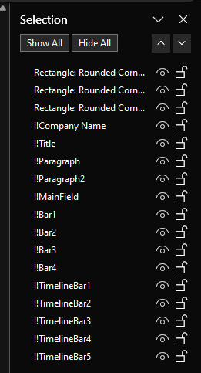
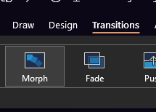

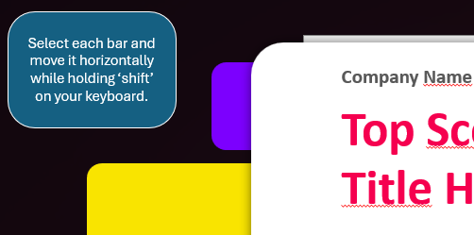
Morph Transitions
Animations are created via ‘Transitions’ Morph Effect.
For Morph effect to work it requires elements to have the same names across two slides, prefixed by ‘!!’.
You can inspect those names via ‘Selection Pane’ that can be found in ‘Shape Format’ tab.
Selection Pane
When two elements on the different slides have the same name with ‘!!’ prefix – they will morph between the slides into each other.
Changing those names or copy/pasting elements might break this relationship – making animations behave differently than intended.
Tooltips
Each Digital Signage comes with tooltips placed outside the slides. Those will guide you on how to adjust this template to your needs.
Using other formats
Use ‘File’ – ‘Save a Copy’ to export this presentation as images, mp4, gif or another format suitable for you.

Slide 3



Press ‘F5’ to let the presentation run in a loop mode.
Transitions take few seconds to play so the signage is not too distracting.
Tropical
Core Feature 1
Core Feature 2
Libero id diam neque pretium quam malesuada. Scelerisque molestie hendrerit primis scelerisque congue dui dictum dictum.
Per leo bibendum molestie fames praesent lacinia molestie sem placerat.
QR

Slide 4

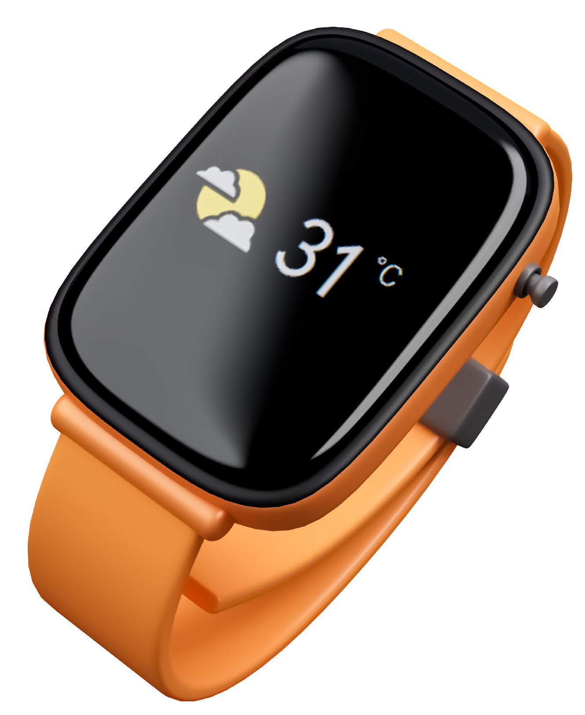
Smart Watch
Core Feature 1
Core Feature 2
Libero id diam neque pretium quam malesuada. Scelerisque molestie hendrerit primis scelerisque congue dui dictum dictum.
Per leo bibendum molestie fames praesent lacinia molestie sem placerat.
QR

Slide 5



Jewlery
Core Feature 1
Core Feature 2
Libero id diam neque pretium quam malesuada. Scelerisque molestie hendrerit primis scelerisque congue dui dictum dictum.
Per leo bibendum molestie fames praesent lacinia molestie sem placerat.
QR

