Slide 1

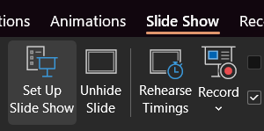
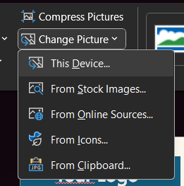

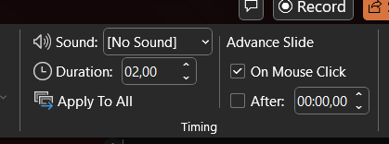
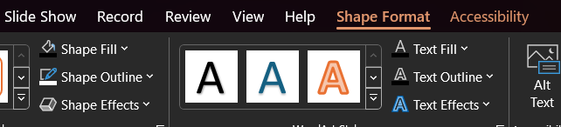
Changing Pictures
Select the image you want to update
Go to ‘Picture Format’ tab
Go to ‘Change Picture’ – ‘This Device’ and select an image.
In the same tab use ‘Crop’ option to adjust the exact image position within the shape.
Animations
Presentation is set to Kiosk mode via ‘Slide Show’ tab’s ‘Set Up Slide Show’ options.
1
3
Transitions are set up via the ‘Transitions’ tab
and set to occur after a specific amount of time,
using ‘Morph’ effect.
4
If you don’t want the animations simply hide one of the slides.
Changing Colors
Use the ‘Shape Format’ or ‘Graphics Format’ tab to edit the colors of each element you’ve selected.
Fonts used
Afacad Flux
Freely available under
SIL Open Font License

Slide 2
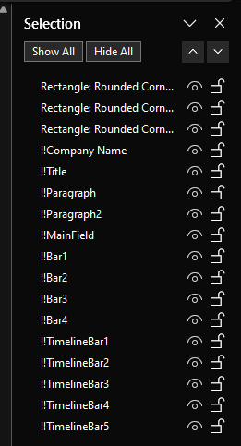
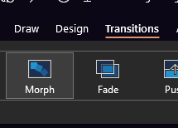

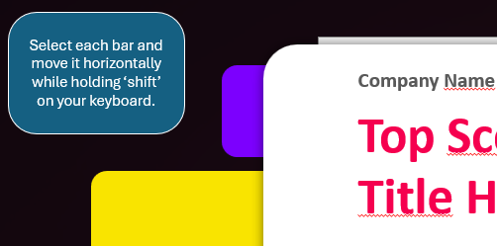
Morph Transitions
Animations are created via ‘Transitions’ Morph Effect.
For Morph effect to work it requires elements to have the same names across two slides, prefixed by ‘!!’.
You can inspect those names via ‘Selection Pane’ that can be found in ‘Shape Format’ tab.
Selection Pane
When two elements on the different slides have the same name with ‘!!’ prefix – they will morph between the slides into each other.
Changing those names or copy/pasting elements might break this relationship – making animations behave differently than intended.
Tooltips
Each Digital Signage comes with tooltips placed outside the slides. Those will guide you on how to adjust this template to your needs.
Using other formats
Use ‘File’ – ‘Save a Copy’ to export this presentation as images, mp4, gif or another format suitable for you.

Slide 3

Mix and match any slides, keeping those you don’t want to use as hidden.
Press ‘F5’ to let the presentation run in a loop mode.
Transitions take few seconds to play so the signage is not too distracting.
Remember to use consistent dates (unless intended)
Upcoming Meetings
04.11 – 10.11
Daily Stand Meeting
Sales Report Overview
Procurement Stream Check-in
Steering Comitee
06.11.2024
06.11.2024
06.11.2024
07.11.2024
Conference Room
10:00
Room B14
12:30
Room C05
13:45
Conference Room
12:00

Slide 4
Upcoming Meetings
14.11 – 20.11
Meeting Title Goes Here
Meeting Title Goes Here
Meeting Title Goes Here
Meeting Title Goes Here
Date
Date
Date
Date
Conference Room
15:00
Conference Room
15:00
Conference Room
15:00
Conference Room
15:00

Slide 5

Upcoming Meetings
04.11 – 10.11
Julia Kirbes
Townhall
Project Overview
Pizza Party!
08.11.2024
08.11.2024
08.11.2024
09.11.2024
You can change picture and adjust texts along with their boxes but do not move any elements.
Happy Birthday!
Conference Room
14:30
Conference Room
16:00
B02
18:00

Slide 6
Upcoming Meetings
14.11 – 20.11
Meeting Title Goes Here
Meeting Title Goes Here
Meeting Title Goes Here
Date
Date
Date
Conference Room
15:00
Conference Room
15:00
Conference Room
15:00

Slide 7
Upcoming Meetings
14.11 – 20.11
Meeting Title Goes Here
Meeting Title Goes Here
Meeting Title Goes Here
Date
Date
Date
Conference Room
15:00
Conference Room
15:00
Conference Room
15:00

Slide 8

Upcoming Meetings
14.11 – 20.11
Name
Surname
Meeting Title Goes Here
Meeting Title Goes Here
Date
Date
Date
Birthday!
Conference Room
15:00
Conference Room
15:00

Slide 9
Upcoming Meetings
14.11 – 20.11
Meeting Title Goes Here
Meeting Title Goes Here
Date
Date
Conference Room
15:00
Conference Room
15:00

Slide 10
Upcoming Meetings
14.11 – 20.11
Meeting Title Goes Here
Meeting Title Goes Here
Date
Date
Conference Room
15:00
Conference Room
15:00

Slide 11

Upcoming Meetings
14.11 – 20.11
Name
Surname
Meeting Title Goes Here
Date
Date
Birthday!
Conference Room
15:00

Slide 12
Upcoming Meetings
14.11 – 20.11
Meeting Title Goes Here
Date
Conference Room
15:00

Slide 13
Upcoming Meetings
14.11 – 20.11
Meeting Title Goes Here
Date
Conference Room
15:00

Slide 14
Upcoming Meetings
14.11 – 20.11
Name
Surname
Date
Birthday!

Slide 15
Upcoming Meetings
14.11 – 20.11
Name
Surname
Meeting Title Goes Here
Date
Date
Birthday!
Conference Room
15:00

